Slide 1








IHE-HL7 Gemini SES+MDI – 2022 RI+MC+RR Strategy– Word – Markdown – AsciiDoc ?
Updated: 2022.07.22
FHIR is a trademark of Health Level 7, International.
SDC is a registered trademark of OR.NET

Slide 2
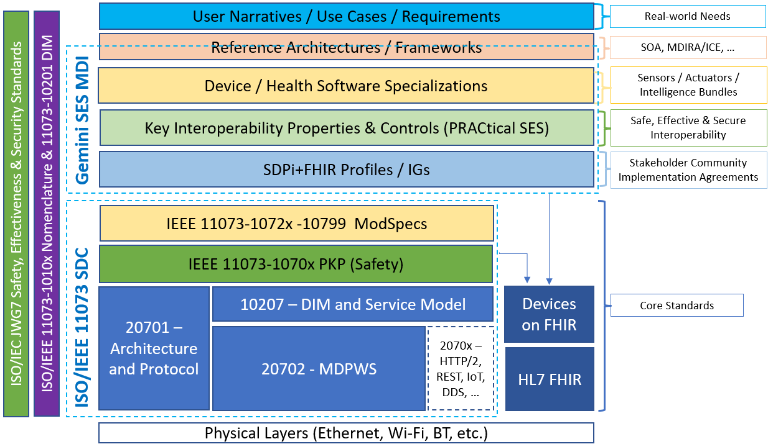
Gemini SES+MDI 2022 RI+MC+RR Strategy Word – Markdown – AsciiDoc ?
Current Strategy: Word “Markup”
ITI Use of Markdown for profiles.ihe.net Publication
ITI Special Pages & DEV OID Scheme
Door #3: AsciiDoc

Slide 3
Gemini SES+MDI – 2022 RI+MC+RR Strategy – Current Strategy: Word “Markup”
…Over the last 2+ years, the Gemini SES+MDI project has settled on am approach for creating and publishing the SDPi technical framework supplement that includes using the Word template as other IHE profiles, supporting RI using styles / bookmarks / links / references, and then processing using scripts that pull out the RI information. How does this kind of Word-based “markup” work and is it an unnecessary compromise?

Slide 4
Spec-to-Test Strategy – RI+MC+RR Model
Basic RI+MC+RR UML Model
“Basic” Requirements Interoperability Model for SDPi 1.0 Document:
Word Constructs:
Style
Link
Bookmark
Need standardized language / conventions for “Requirement” specification
SDPi Requirement
link
Capability
0..*
0..*
“is a”
1..1
0..1
0..1
0..1
Use Case
Ref. Standard ICS
SES
Technology
Capability provides implementation for Requirements
Considerations / Homework:
Word references / links require “bookmarks” – set places in the document (see also PKP examples)
Word “styles” will require some naming method of each style / link / Bookmark to ensure continuity
“Capability” Types needed?
Identifiers / nomenclature required? SDPi Rxxxx? “Link” text?
Create examples for each, including Text in Word + Word XML rendering
Bidirectional navigation? Unidirectional (req to capability) sufficient? (Note: 0..* simply indicates that each end can be linked to / from multiples on the other side of the relationship)

Slide 5

Spec-to-Test Strategy – RI+MC+RR Model
Basic RI+MC+RR UML Model
ReqIF Example: Requirement related to System Function Contribution
<w:p w14:paraId="5672C5E0" w14:textId="77777777" w:rsidR="00743536" w:rsidRDefault="000A5E66">
<w:pPr> <w:pStyle w:val="IEEEStdsParagraph"/> <w:jc w:val="left"/> </w:pPr>
<w:bookmarkStart w:id="123" w:name="Requirement:R0062"/>
<w:r> <w:rPr> <w:b/> </w:rPr> <w:t>R0062</w:t> </w:r>
<w:bookmarkEnd w:id="123"/>
<w:r> <w:rPr> <w:b/> </w:rPr>
<w:t>: If an SDC PARTICIPANT produces EXCESSIVE LOAD CONDITIONs, each SDC PARTICIPANT that is affected by these conditions SHALL maintain its SYSTEM FUNCTION CONTRIBUTIONs for other SDC PARTICIPANTs.</w:t>
</w:r>
</w:p>
IEEE p11073-10700
(Draft 1 – Under the Hood)
IEEE p11073-10700
(Draft 1)
Observation: ReqIF Used for Document Creation – Not requirements formalization!

Slide 6
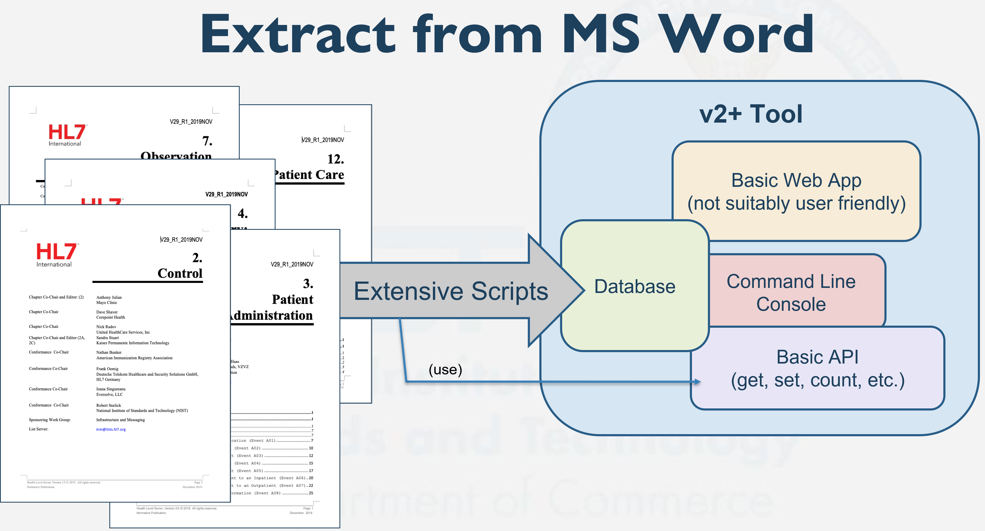
Spec-to-Test Strategy – To a SST Database
Word Styles / Bookmarks / Links
Basic RI+MC+RR UML Model
SDPi 1.0
Specification
Used to create DB schema
“Simple” Word Docx
Michael’s Amazing Word-to-Database Transformation Tool
SDPi RI+MC+RR Database
“Single Source of Truth”
Road to an SDPi 1.0
Single Source of Truth Database:
Source: Michael Faughn 2022 January WGM Update / V2plus Project
Build SDPi 1.0 Word document w/ content aligned to basic RI+MC(+RR) UML model
Utilize UML Model to create database schema
Utilize “Extensive Scripts” to extract content from Word documents to Database

Slide 7
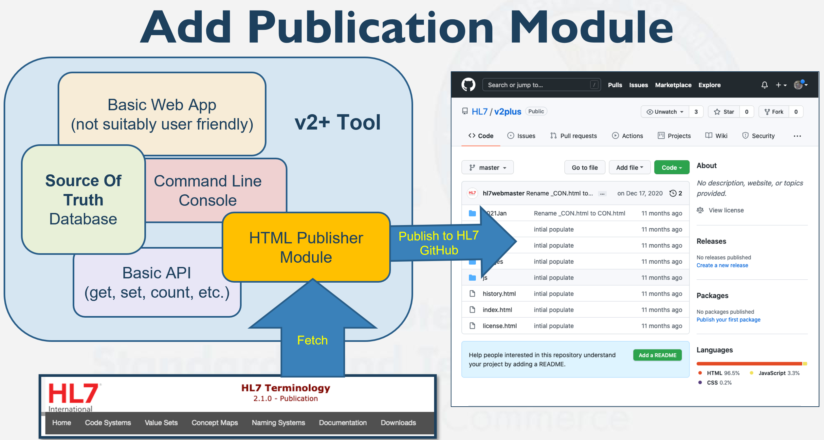
Spec-to-Test Strategy – SDPi 1.0 Specification
SDPi 1.0
Specification
Word doc integrating “basic” RI+MC+RR support (see preceding slides)
Constrained to roadmap capabilities
Published as PDF (traditional)
Supporting RI import to database
(See next slide)
Pilot Goal: HTML Publication
(may require integration of IHE TF elements to UML model – beyond “basic” RI+MC+RR)
Source: Michael Faughn 2022 January WGM Update / V2plus Project

Slide 8
Spec-to-Test Strategy – Word Open Issues
Word-approach Challenges …
Finalize examples for each of the RI “types”, including:
Use Case Based Requirements
Normative Referenced Standards “ICS” Requirements
Technical vs. Process (EP) requirements
SES Requirements
Technical-to-Technical Requirements
Define “systematic name” scheme for Styles / Bookmarks / Links
Finalize UML models for RI +
“Extensive Scripts” for extracting RI information into a SST Database
…

Slide 9
Gemini SES+MDI – 2022 RI+MC+RR Strategy – ITI Use of Markdown for Publication
…ITI currently uses Markdown to format its specification, including the expansive ITI technical framework and supplement documents. These are then published to profiles.net.net utilizing HL7’s IGPublisher tool, from the associated ITI and PUB github repositories. How does that work? Can IHE DEV SDPi utilize the same Markdown format without also leveraging the IGPublisher?

Slide 10
Spec-to-Test Strategy – ITI TF & Markdown
Considering that IHE TF publication – especially for ITI TF – is now:
Markdown based (aligned with HL7 FHIR content OR simple IHE TF markdown template)
Content either morphed from Word (existing profiles) / recommended hand-crafted markdown
Utilizes the FHIR IGPublisher for conversion to HTML
Publishes to a HTML-navigatible (“short form”) at profiles.ihe.net/iti
Recommendations for future IHE specification work is to leverage this process & tooling
How would the SDPi 1.0 TF utilize this current IHE approach?
Resources to review …
IHE publication information / github wiki topics are github.com/IHE/publications/wiki
The ITI index page is profiles.ihe.net/ITI/
The ITI github repo is github.com/IHE/ITI
Examples for creating a new repo for a specific supplement for the DEV TF …
https://github.com/IHE/ITI.mCSD (created via IG Publisher – FHIR-based profile)
https://github.com/IHE/ITI.IUA (created using GitHub and Markdown – non-FHIR-based profile)

Slide 11
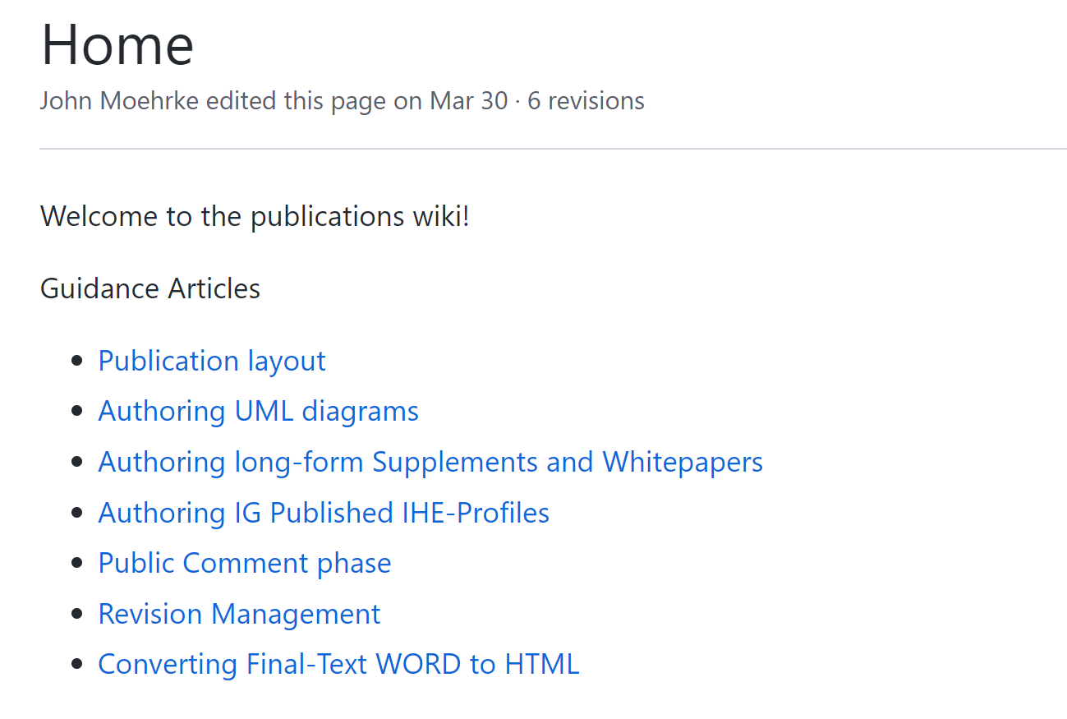
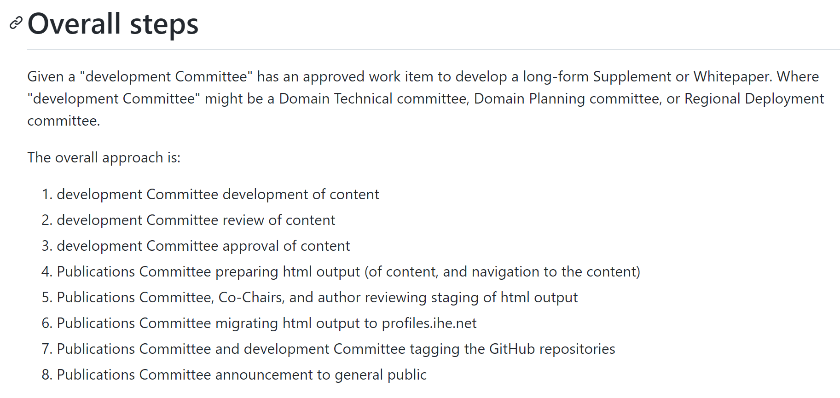
Spec-to-Test Strategy – From Publications Wiki
*
*
DEV / Gemini SDC/SDPi Team Responsible for crafting +
AsciiDoc-based Content can be easily integrated into IHE github repo’s & rendered to ihe.github.io for domain-internal + public comment review

Slide 12
Spec-to-Test Strategy – From Publications Wiki
Long-form / Short-form
Long-form = IHE “Classic” Documents (published as a single HTML page)
SDPi – Short-form only (file granularity? … see next)
IHE DEV TF 2022 Edition? (use AsciiDoc … easier future integ.)
Markdown & GitHub Integration
Markdown & Github vs. Word & Google Drive
Repo Name: DEV.SDPi or DEV.SDPi-P (refactor sdpi-fhir for now)
Publish repo to “Github Pages” (ihe.github.io/)
Handcraft markdown content in GitHub Editor (can use markdown WYSIWYG editor but …)
Markdown ➔ HTML via PanDoc
Note: PanDoc supports AsciiDoc as well
Pre-pub review @ ihe.github.io/publications (via repo “Pages”)
Published via FileZilla to profiles.ihe.net/
pandoc -r gfm --template=https://github.com/IHE/publications/wiki/ihe_template.html --metadata title="HIE-Whitepaper" --metadata path-prefix="../../" -w html -o index.html README.md

Slide 13
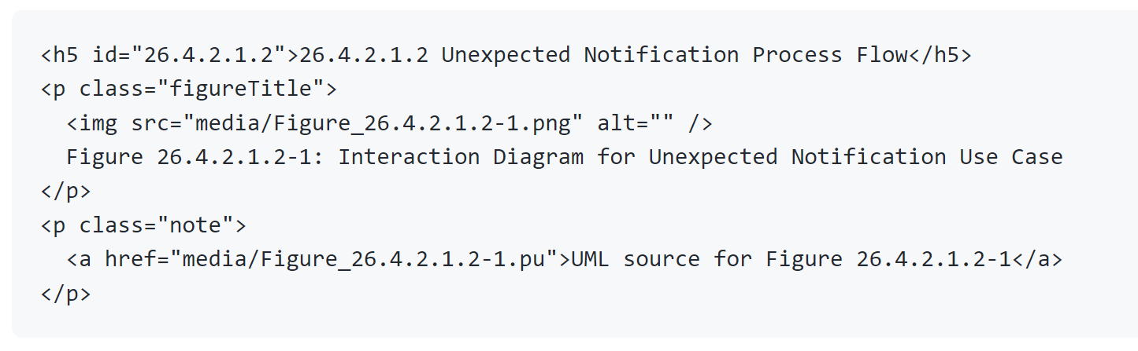
Spec-to-Test Strategy – From Publications Wiki
Publication Layout
Provides folder structure @ profiles.ihe.net
TF Volumes + Supplements + Papers + non-domain specific profiles.ihe.net/GeneralIntro
Authoring UML Diagrams
Use PlantUML (.pu / .plantuml)
Include a link to the .pu file next to the diagram
Note: auto rendering not currently supported – given potential risk of variation after publication with changes in underlying infrastructure
File naming:
Figure 8.6.4-2 (per IHE naming conventions)
media/Figure_8.6.4-3.png & media/Figure_8.6.4-3.pu
IGPublisher – Call for SVG image …
HTML Example ➔
Source: github.com/IHE/publications/wiki (drafted by John Moehrke)

Slide 14
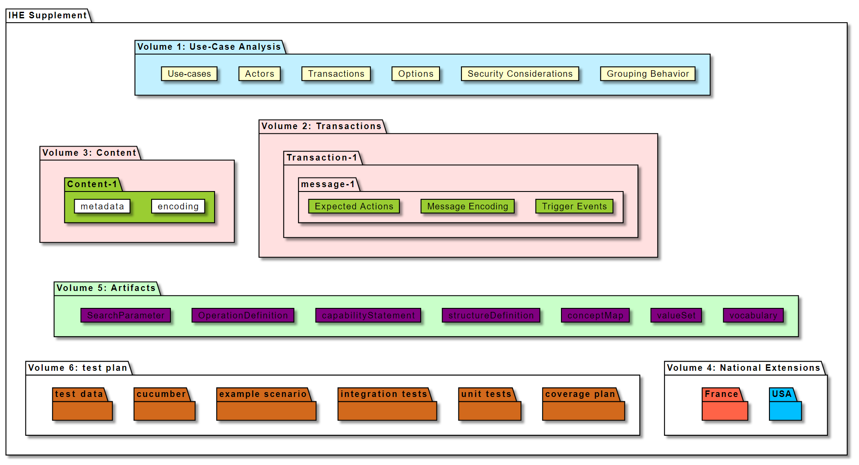
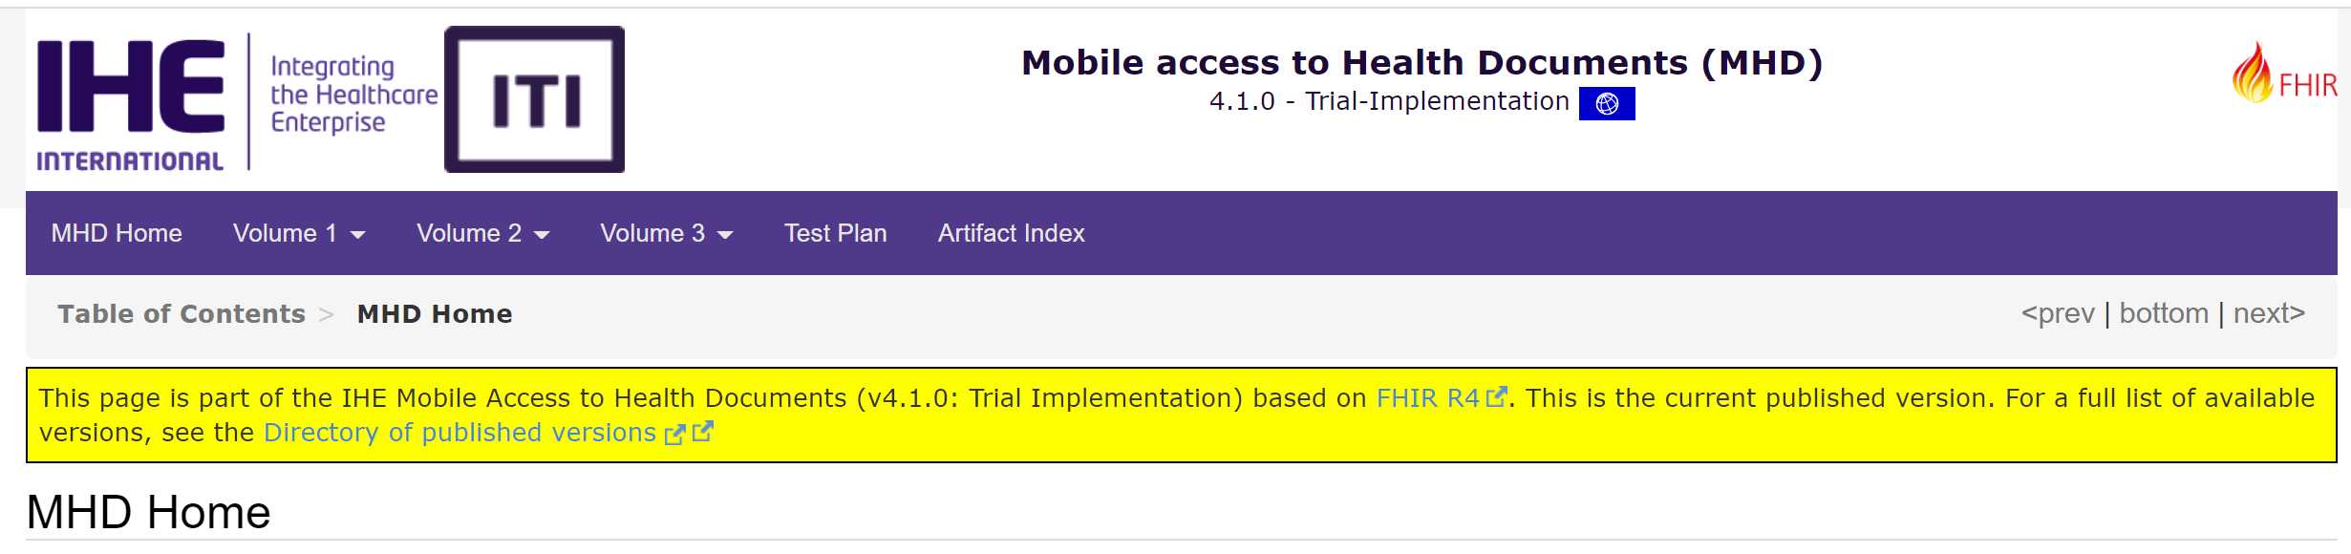
Spec-to-Test Strategy – From Publications Wiki
See: Active IHE Projects Using the IG Builder
Supplement organization supported by IG Publisher …
See IHE supplement template @ build.fhir.org
MHD Source @ https://github.com/IHE/publications/tree/master/ITI/TF

Slide 15
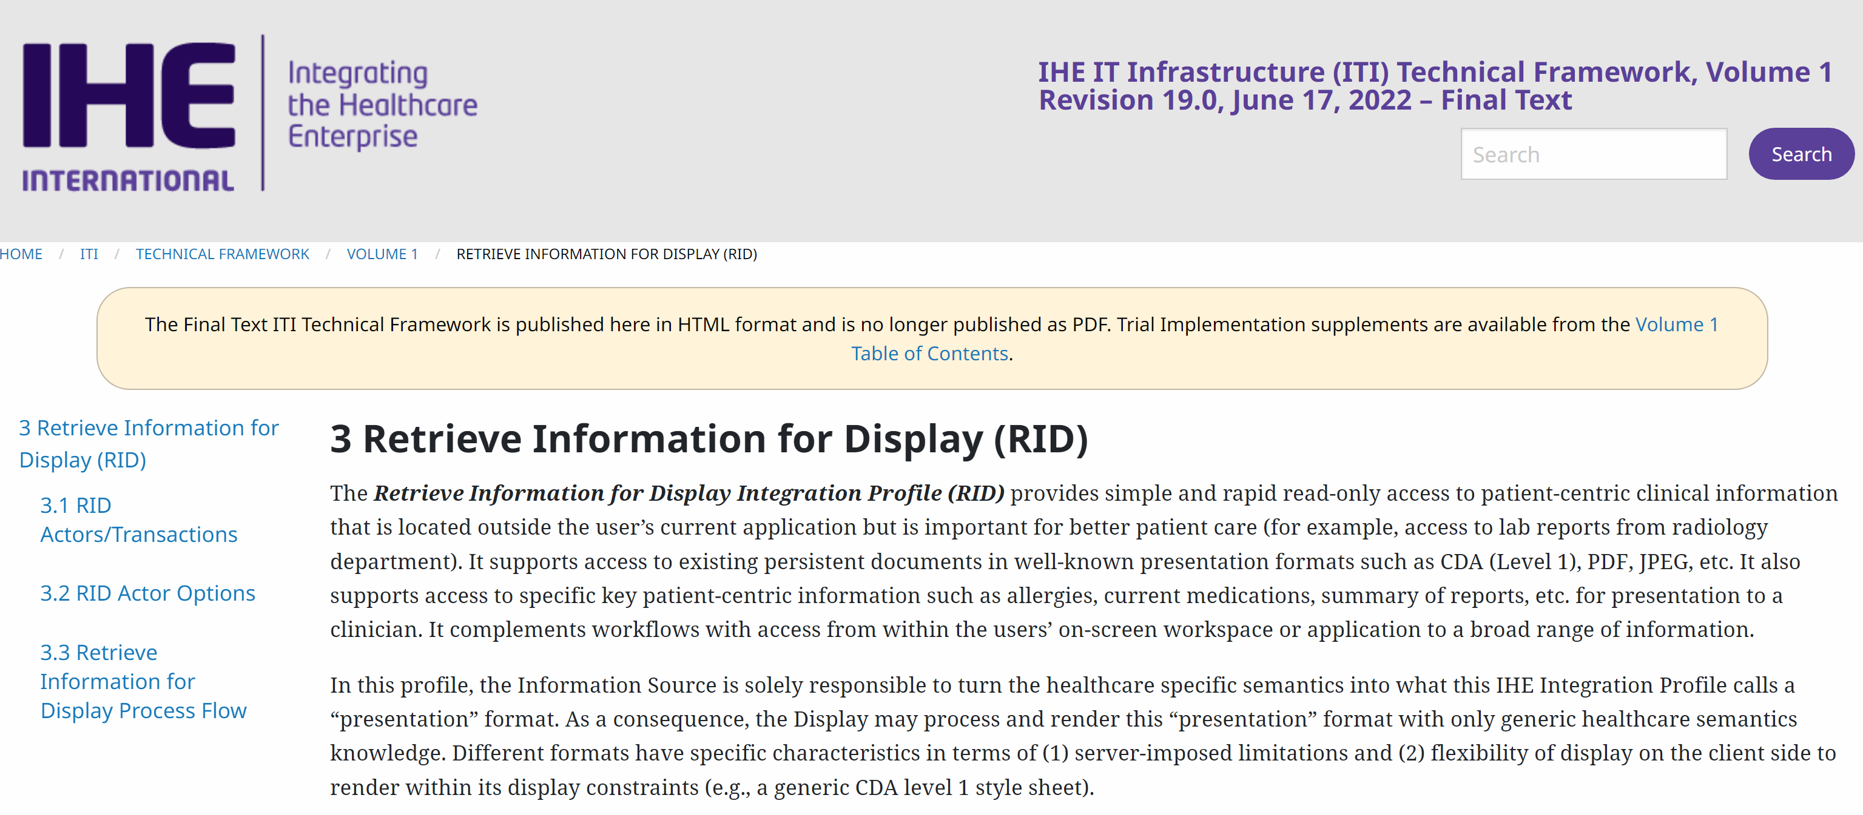
Spec-to-Test Strategy – From Publications Wiki
IHE Supplement Template in markdown:
raw.githubusercontent.com/wiki/IHE/supplement-template/suppl_template.md
See example ITI IUA Profile: https://github.com/IHE/ITI.IUA/blob/master/IHE_ITI_Suppl_IUA.md (uses gmf – github markdown format)
See the extended TF structure @
https://github.com/IHE/publications/tree/master/ITI/TF
(IHE ITI TF is ONLY maintained in HTML, no Word or markdown sources – since FT generally requires few and limited changes)

Slide 16
Spec-to-Test Strategy – Markdown Open Issues
Markdown-approach Challenges …
Can the use of markdown in the IHE publication (esp. ITI TF) process & tool chain be utilized for SDPi 1.0 purposes? Into the future? [yes, but why…]
Can the general “short form” architecture be leveraged for SDPi specification purposes? (w/o sacrificing RI + w/o More-Hacking-Required) [short form – yes; markdown – no]
Can the current IHE TF (esp. ITI TF) production & publication process & tool chain be leveraged but utilizing AsciiDoc? [Generally – yes; IG Pub? No]
Can an “enhanced” approach for SDPi be established that will be … “welcomed” … by IHE stakeholders, especially publications? [Stay tuned!]
…
Also: IHE Profiles vs. IHE Implementation Guides … Same? Different?

Slide 17
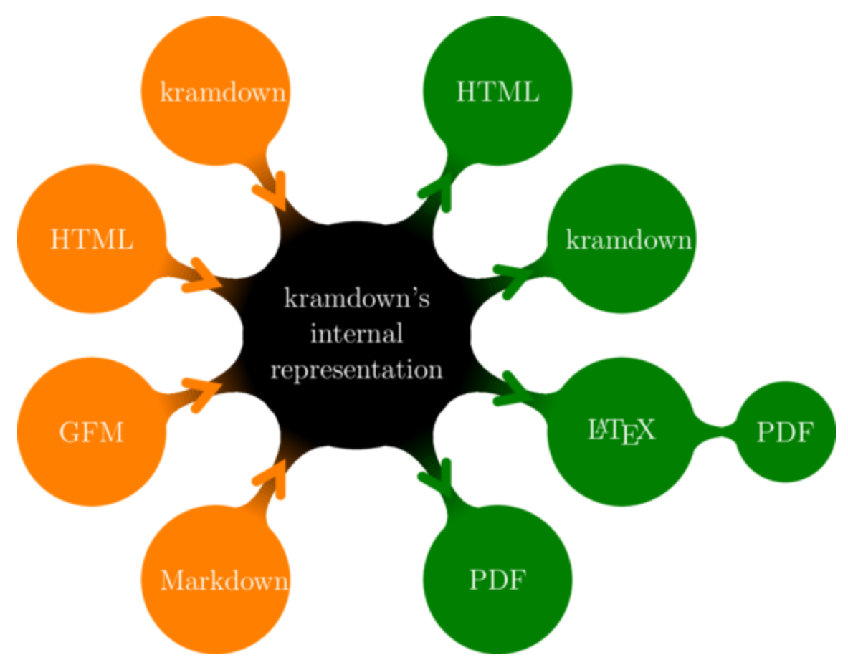
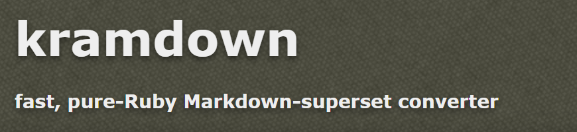
Markdown/kramdown – What is it?
Used by HL7 FHIR & IHE FHIR-Based Publications …
… is a TOOL for processing markdown “flavors” + for providing some extension capabilities
(note: kramdown claims to be a “superset” of markdown … but not a markdown flavor … ???)
See: kramdown Quick Reference
Source: kramdown home page

Slide 18
Gemini SES+MDI – 2022 RI+MC+RR Strategy – ITI Special Pages & DEV OID Scheme
One approach to publishing the updated IHE Devices OID scheme, including extensions supporting the SDPi profiles, is to leverage the approach that ITI developed for publishing tables of various identifiers and value sets.

Slide 19
IHE DEV OID Publication – Leverage ITI Approach?
Given the need to update and re-publish the IHE DEV OID allocations …
Question:
Should we use an approach analogous to what IHE / ITI uses today (e.g., IHE FormatCode identifiers)?
Example: https://profiles.ihe.net/fhir/ihe.formatcode.fhir/ValueSet-formatcode.html
Github Source: https://github.com/IHE/FormatCode/tree/master/input/resources
Answer:
Yes, but in a way that is consistent with the DEV TF & SDPi Supplement

Slide 20
Gemini SES+MDI – 2022 RI+MC+RR Strategy – Door #3: AsciiDoc
In addition to using a Word-based document or a Markdown-based document, AsciiDoc is a 3rd option that may be better able to author the technical SDPi profile specifications, as well as all artifacts created / generated in the SDC/SDPi+FHIR Gemini program.

Slide 21
Option #3: What is: AsciiDoc?
“AsciiDoc is a plain text markup language for writing technical content. It’s packed with semantic elements and equipped with features to modularize and reuse content. AsciiDoc content can be composed using a text editor, managed in a version control system, and published to multiple output formats.”
[AsciiDoc]
Note: AsciiDoc is NOT a markdown flavor – it is a language purpose-built for technical specifications, with an extensive support community and tooling integration.
Source: David Gregorczyk / Dräger

Slide 22
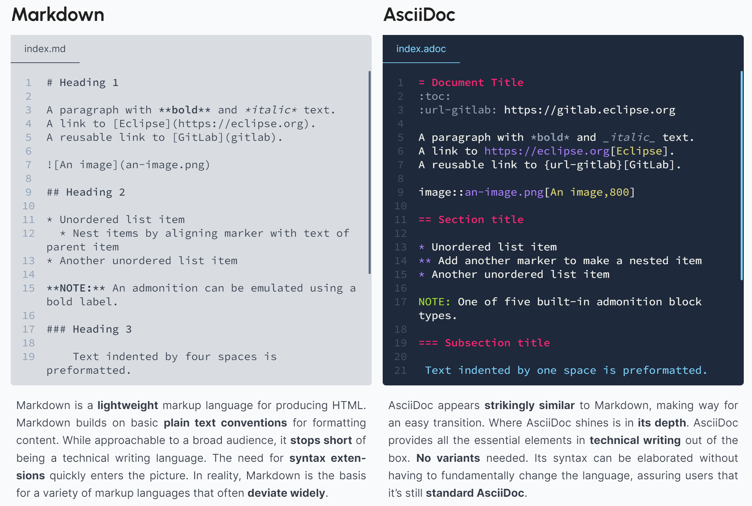
Option #3: AsciiDoc – Comparisons?
HL7 FHIR & IHE use:
markdown
To support integration with HL7 FHIR Tooling
Source: AsciiDoc.org / “HOW ASCIIDOC STACKS UP”

Slide 23
Option #3: AsciiDoc – How does it work?
GitHub “actions” can be used to automagically transform AsciiDoc inputs …
Asciidoctor Diagram
Plugin (PlantUML, SVG, etc.)
Asciidoctor
Rendering
SDPi
.pdf
SDPi
.adoc
AsciiDoc Toolchain
SDPi
.html
Note: intelliJ platform can be used, with the AsciiDoc IntelliJ plugin + Asciidoctor Diagram (to render PlantUML)
Source: David Gregorczyk / Dräger

Slide 24
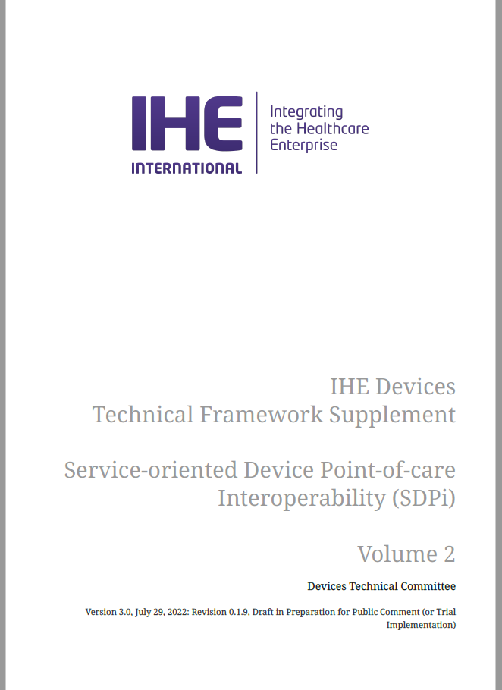

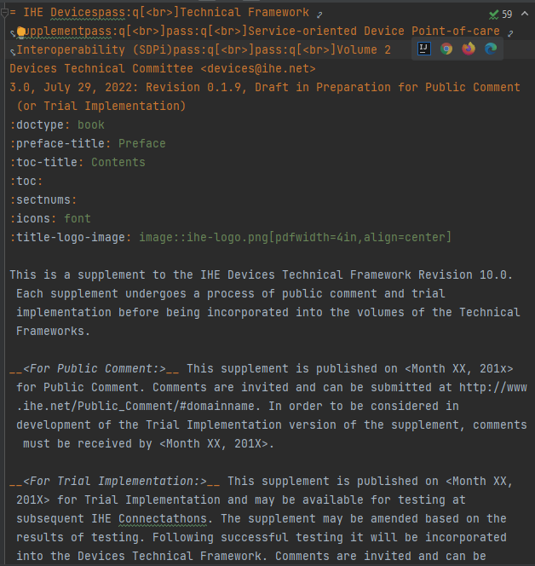
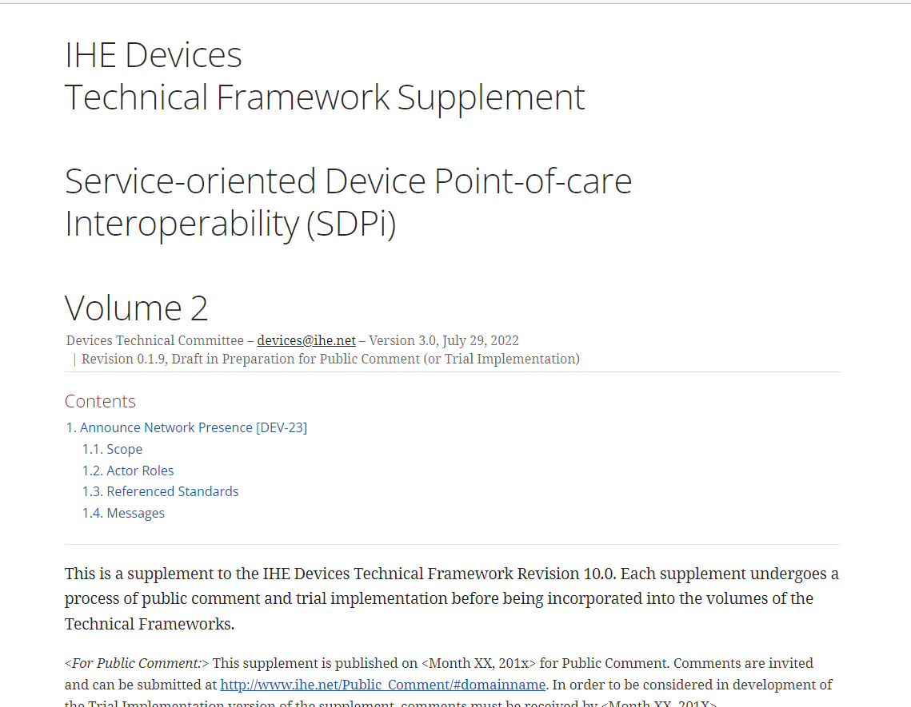
Option #3: AsciiDoc – Artefacts?
There is even a plugin
to convert to Word
To PDF
To HTML
I am edited in IntelliJ, VS Code, or just in a Text Editor
Source: David Gregorczyk / Dräger

Slide 25
Gemini SES+MDI – 2022 RI+MC+RR Strategy – Selection: Word / Markdown / AsciiDoc
Given the primary three options for SDPi specification content creation to publication, how do they compare today? Which should be selected for finalizing the SDPi 1.0 specification content?

Slide 26
Spec-to-Test Strategy – Why AsciiDoc?
AsciiDoc was selected as the best path forward for SDPi … why?
Word is a short term “hack” at best …
IHE has already moved from Word to markdown & HTML publication
Markdown was created for simple commenting and on-line content –
Publication in PDF and HTML works but support for RI+MC+RR … not so much
AsciiDoc provides the best approach today for advancing to RI+MC+RR…
Strong built-in support for embedding metadata + defining type / object extensions
Can support model-based content now, better supporting integration into a single-source of truth specification database
Can support ALL the document-based artifacts created / consumed by the SDPi+FHIR program … including test-related assertions, scripts, and reports
Broad tooling support and platform integration + support community is equivalent to that of markdown
Content editors today will have to use either markdown or AsciiDoc or similar – pathway for integration of other sources (e.g., Word) to AsciiDoc is easily achieved
Support for Gherkin and other extensions already in place

Slide 27
Spec-to-Test Strategy – Moving to AsciiDoc
How will the transition to AsciiDoc be achieved? Next steps?
From the 7/15 SDPi Discussion …
Use github sdpi-fhir wiki pages to start documentation of the specification creation to publication approach
Start with a simple "How to author and generate AsciiDoc specs?" for newbies (including test editors, platforms (IntelliJ & VS Code ...) etc.
Add AsciiDoc base (master) file (<supplement name>.adoc main file) and (tbd) subfolders to the github SDPi-FHIR repo folder: SDPi Supplement / SDPi Rev 1.0 /
Add initial AsciiDoc_Support folder to collect items, including David Gregorczyk 's demo program project
Rename folders in this tree to replace spaces with underscores
Define the kinds of AsciiDoc blocks that will be needed for the specification (e.g., per IHE TF specifications and artifacts)
Include those needed for requirements interoperability & links to testable assertions
Create an initial set of AsciiDoc templates to support the "blocks"
Configure github actions to support production of the specification, both in a "long form" PDF document as well as in an HTML "small form" / multi-file publication
Begin migration of content to AsciiDoc “platform” starting with simple end-to-end use case based threads
Explore use of AsciiDoc content for Test Scripting & Test Reporting
Question: For requirements in SDPi 1.0, can SysML 2.0 KerML be used to define the requirements NOW, at least in the UML modeling, and thus better supporting migration to more robust MC specifications in the future?

Slide 28
Spec-to-Test Strategy – Next Steps++
Based on discussions & decisions per IHE publications process & tooling review …
Create initial AsciiDoc-based content in the sdpi-fhir repo
SDPi_Supplement folder
Update and archive the content under the “SDPi Rev 1.0” folder
Content Authoring Platform:
Many AsciiDoc tools exist, but for a starting pass … see “tool chain” slide above:
intelliJ platform can be used (open “Community Edition), with the AsciiDoc IntelliJ plugin + AsciiDoctor Diagram plugin (to render PlantUML)
Use sdpi-fhir repo wiki to document process and tooling being utilized
As is done with the current IHE Publications and related github wiki pages
Configure sdpi-fhir repo “Pages” to auto-publish to ihe.github.io [TBD]
Rendering: To the greatest degree possible, specification content will be separated from rendering + focus 1st on HTML .. PDF if / when needed

Slide 29
Spec-to-Test Strategy – Next Steps++
Content File Structure
Multi-file approach that leverages both the current TF chapter level + IG Publisher level
Minimize “magic numbers” in the content (e.g., document outline sections embedded)
Support a Table of Contents but with URIs vs. pervasively embedded section #’s
Use github …
“Actions” to automagically transform committed updates to rendered HTML
“wiki” to document content development processes & tool chain
“project” for migration of current Word version to initial baseline
“issues” to connect with Topics of Interest to resolutions to “Issues” in supplement
“Kanban” board to manage a To Do backlog
Use PanDoc to convert Word to AsciiDoc …
1st pass at IHE DEV TF
Simple content from Word-based contributions to AsciiDoc for integration
AsciiDoc idiomatic paradigm will be fully utilized + github

Slide 30
IHE-HL7 Gemini SES+MDI – 2022 RI+MC+RR Strategy– Word – Markdown – AsciiDoc ???
FHIR is a trademark of Health Level 7, International.
SDC is a registered trademark of OR.NET

Slide 31
Additional Materials

Slide 32
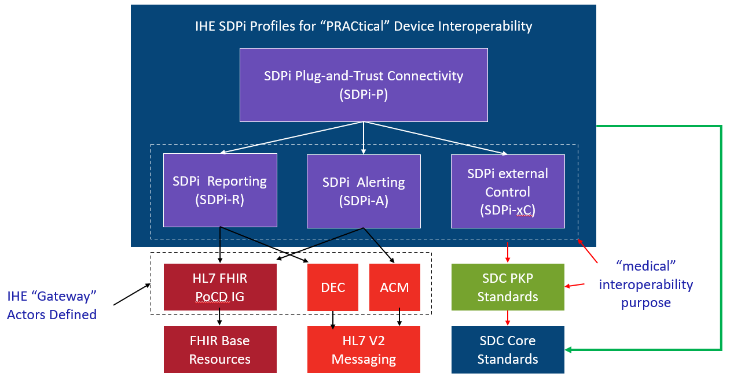

Orientation Tour: IHE TF & SDPi Profiles
Service-oriented Device Point-of-care Interoperability (SDPi)
Four profile specifications:
SDPi-P for Plug-and-Trust Interoperability
SDPi-R for Reporting Medical Information
SDPi-A for Alerting
SDPi-xC for External Controlling
Three IHE DEV TF Volumes:
TF-1 Profiles / use cases / actors / …
TF-2 Transactions / MDPWS messaging
TF-3 BICEPS content modules / device specializations
See draft SDPi Supplement Word Document for additional content detail & outline (https://github.com/IHE/sdpi-fhir/tree/master/SDPi%20%20Supplement/SDPi%20Rev%201.0)

Slide 33
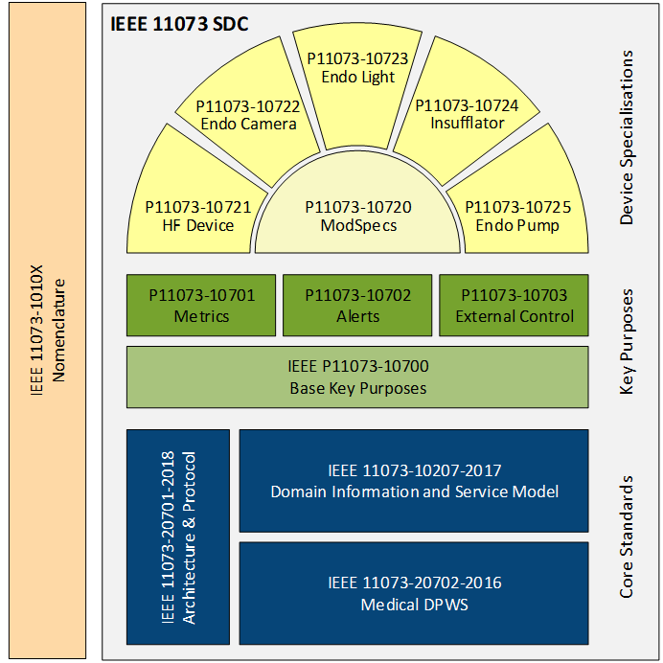
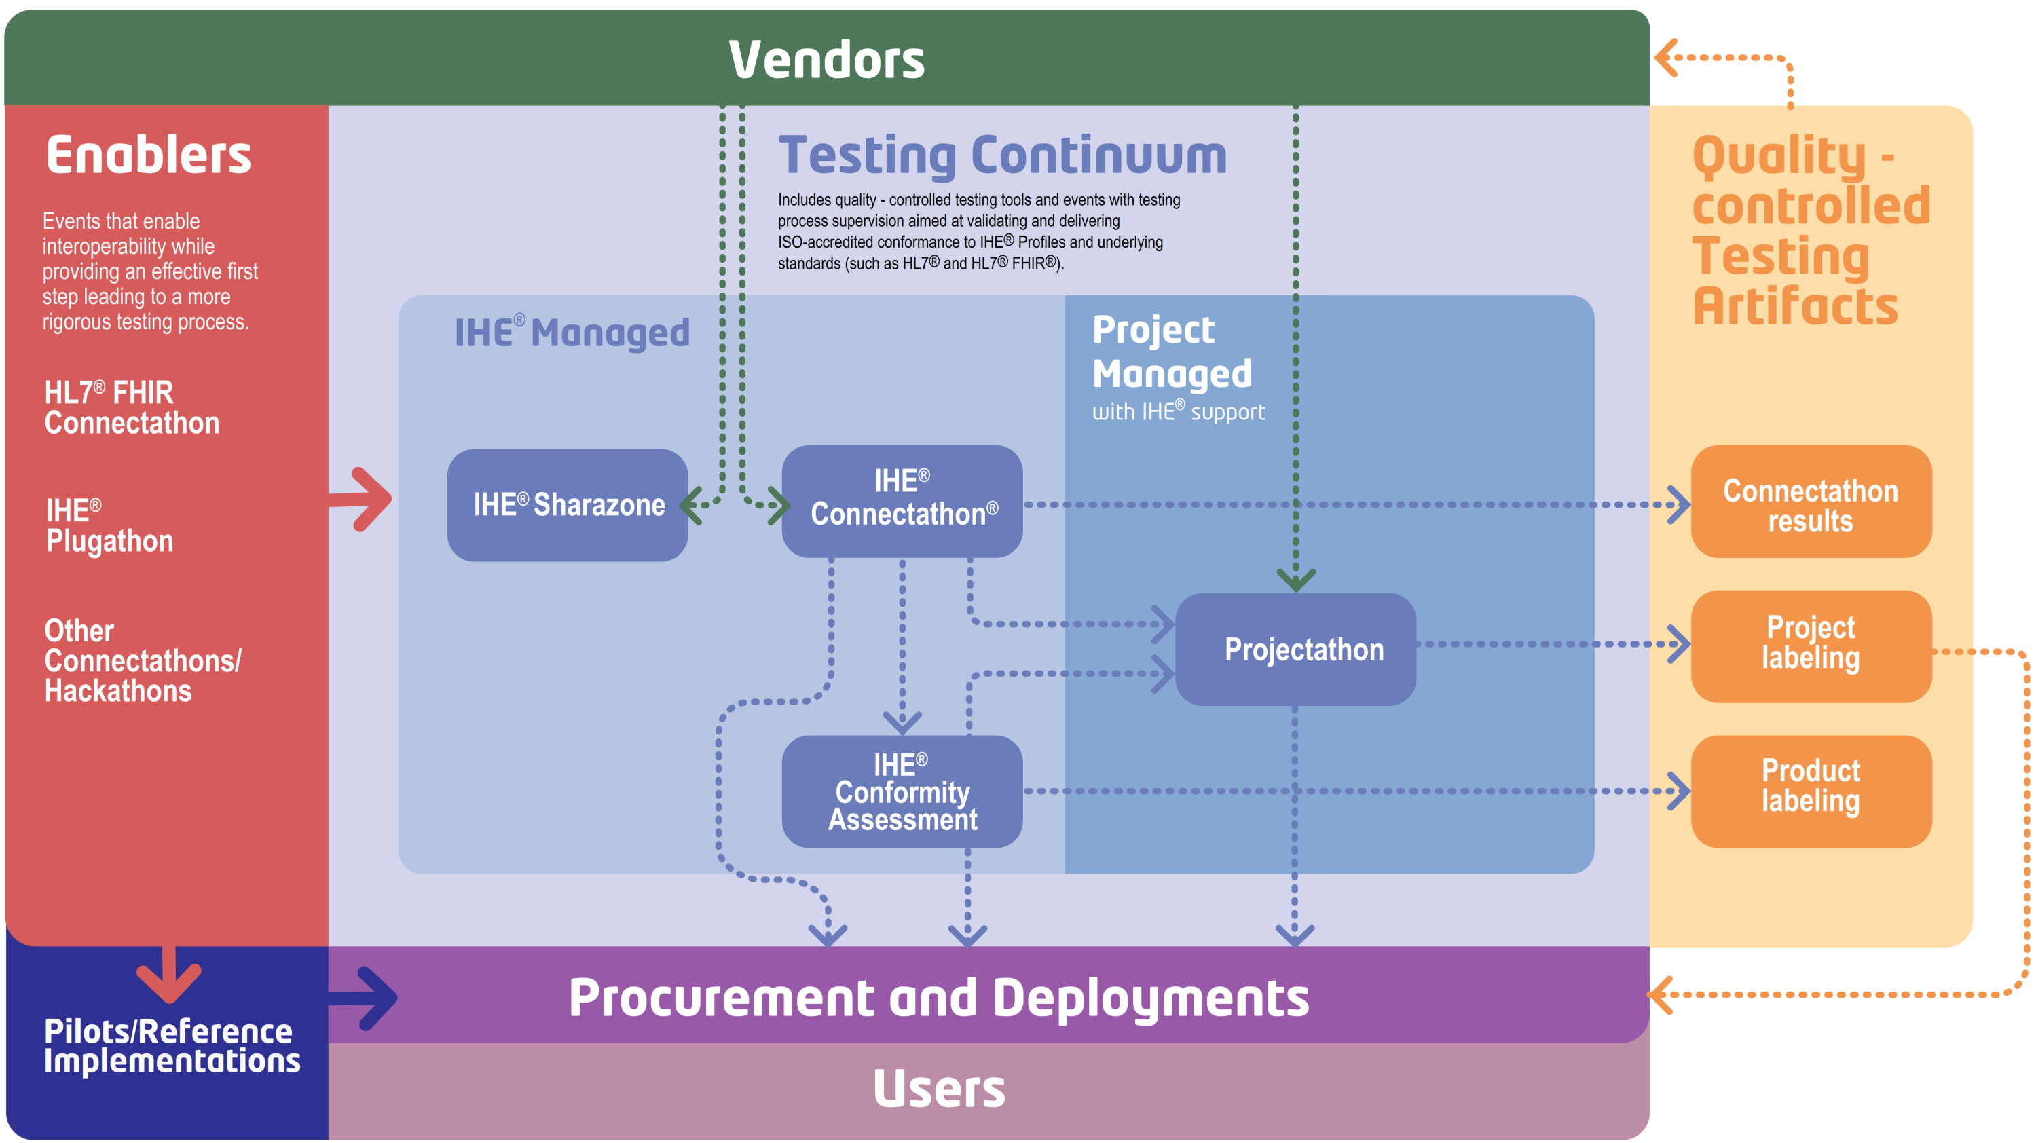
Spec-to-Test Strategy – Closing the Loop / EP Style
Traceability & Coverage back to 11073-1070x PKP ICS Specifications (via “RI”)
IEEE 11073-1070x Project Teams
Gemini SES+MDI Community
CA “RR”
Test Report
Develop
Develop
11073-1070x PKP Standards
IHE SDPi TF Specifications (TF-1 / Appendix B)
SES+MDI SDC/SDPi+FHIR
Test Plans/Scripts + PAT/CAT + Product CA
Require-ments
PKP ICS Tables

Slide 34
From Specs to Test Reports – ”Basic” Strategy
Word Styles / Bookmarks / Links
Basic RI+MC+RR UML Model
Gazelle Test Management Tool
SDPi 1.0
Specification
Used to create DB schema
Basic test instance metadata provided to Test Tool … somehow
Content integrated manually …
“The Old Fashioned Way”!
“Simple” Word Docx
Michael’s Amazing Word-to-Database Transformation Tool
SDC/SDPi Test Tool
Test Script Info
Report document “attached” to test instance and reviewed by Monitor
SDPi RI+MC+RR Database
Driven by Use Cases, Standards Conformance, SES & Tech Requirements
Generated by tool w/ test instance metadata integrated
SDPi 1.0
Test Plans & Scripts
Test Case (Instance) Report
“Single Source of Truth”
Links from test plans / scripts to RI elements (enabling traceability / coverage)
Crafted & Maintained Independent of
Test Tooling
Legend
Automated
Manual / Semi-auto
“RR” Report – Supporting Evidence

Slide 35
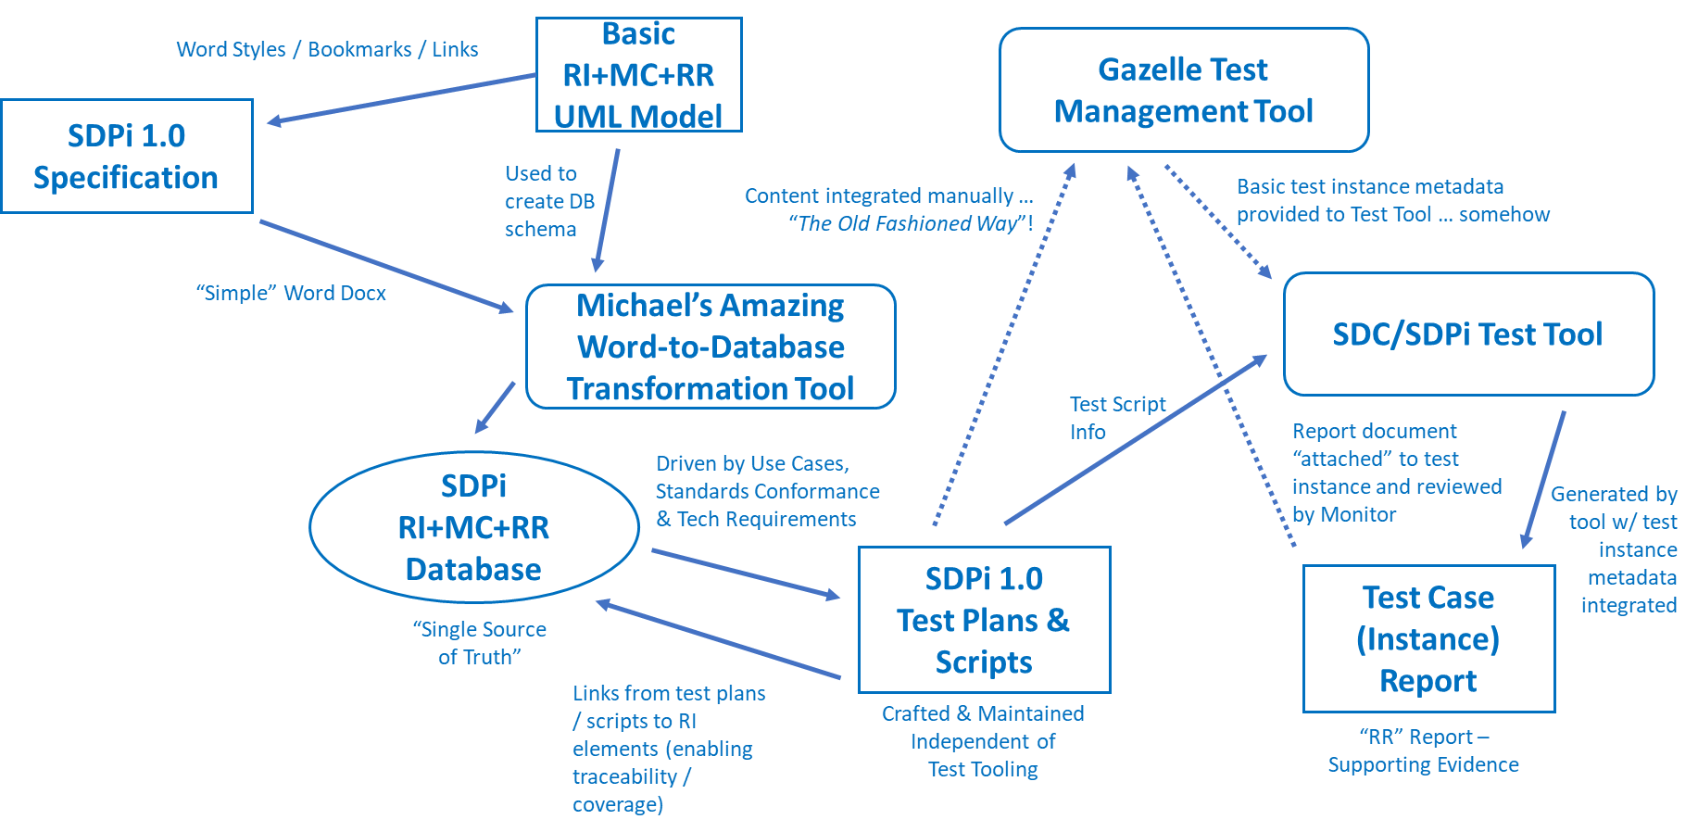
Spec-to-Test Strategy – “RR” Test Reports?
Traceability & Coverage back to 11073-1070x PKP ICS Specifications (via “RI”)
What is the strategy for getting to a “regulatory submission ready” product CA test report?
IEEE 11073-1070x Project Teams
Gemini SES+MDI Community
CA “RR”
Test Report
Develop
Develop
IHE SDPi TF Specifications (TF-1 / Appendix B)
SES+MDI SDC/SDPi+FHIR
Test Plans/Scripts + PAT/CAT + Product CA
11073-1070x PKP Standards
Require-ments
PKP ICS Tables
Test results currently are persisted in the Gazelle testing / CA database …
Should SDPi 1.0 test report results be incorporated into the SST database to link with RI-to-Test Case information?
Should a separate test results database be created? + A tool that can combine the multi-database content to create a RR CA report?
How are CA test reports created today? Historically? Separate tool from Gazelle? Extended Gazelle instance?

Slide 36
Spec-to-Test Strategy – RI+MC+RR Model
Basic RI+MC+RR UML Model
SDPi 1.0
Test Plans & Scripts
“Basic” Requirements Interoperability Model for Test Plans/Cases:
SDPi RI+MC+RR Database
Note: Model for early discussion purposes only (not formal UML!)
0..*
0..*
SDPi Requirement
link
Capability
Test Assertion
0..*
Test Plan
0..*
0..*
1..*
0..*
0..*
1..*
1..1
Word-based Specification
Test Plan-Scenario Context Information
1..*
1..1
Test Scenario
1..*
Test Scenario Execution Report
Considerations / Homework:
Test Assertion to Test Scenario key to RI
Cardinalities? (Navigation? is it 1:1 or 1..*)
Test Assertions are external to Word spec. – SST DB or Separate File?
…
Test Plan Execution Report

Slide 37
Spec-to-Test Strategy – To Gazelle Integration
Gazelle Master Model (GMM) –
GMM content leveraged by all instances of the test management tool
All profile & test information entered manually via GMM UX
Gazelle Test Management Tool
1..1
Profile
AIPO
1..*
1..*
SDPi 1.0
Test Plans & Scripts
Actor / Integration Profile / Profile Option “Tuple”
1..*
1..1
2..*
1..*
Actors
link
Transactions
1..*
1..*
Test Summary
1..1
Gazelle Test Definitions –
Consists of four components (detail on following slides)
GMM Test elements must be mapped from
Test automation mostly external to Gazelle TM/GMM
Note: Actors & Transactions are Profile independent
Question: “link” cardinality 2..2 or 1..* or … ???
Question: “links” are also “initiator” & “consumer”
Test Description
1..1
Test Definition
Test Roles
1..*
1..*
1..2
Steps
1..*
{ordered}
Source: GMM User’s Guide

